Slide 1
Gender Identity In Social Care

Slide 2
ME
I believe equality and diversity is one of the most important aspects of a business and helps to develop new ideas and can progress all of our life experiences! Life would be boring is we were all the same!
Lover of history, fashion, culture and finding beauty in everything and everyone
Not afraid to have difficult conversations
Member of the LGBTQIA+
I know that there is never a right answer that will suit every situation when it comes to gender and sexuality. It is different for everyone!
Part of Leicesters Drag community so gender is spoken about freely and without discrimination

Slide 3
What is Gender?
Gender refers to the characteristics of women, men, girls and boys that are socially constructed. This includes norms, behaviours and roles associated with being a woman, man, girl or boy, as well as relationships with each other. As a social construct, gender varies from society to society and can change over time.
These gender norms – especially those related to rigid notions of gender can be very harmful. They should be worked towards being more neutral from all angles.
Stereotypical Male Jobs
Construction
Mechanic
Farming
Outdoor Work
IT
Stereotypical Female Jobs
House Wife
Child Minder
Cook
Cleaner
Care Professional

Slide 4
The Gender Spectrum
Female
Non-Binary
Male
SHE/HER
THEY/THEM
HE/HIM

Slide 5
Non – Binary
Non-binary’ is an umbrella term for people who:
don’t solely identify as either male or female
identify as both male and female
identify with another gender
don’t identify with any gender
Because the binary terms of ‘male’ and ‘female’ don’t fit, using pronouns such as ‘he’ or ‘she’ might not always be right, so when you talk to someone who’s non-binary try to find a good moment and ask them how they would prefer to be addressed. The person might use ‘they’, ‘he’ or ‘she’ pronouns, something different, or no pronouns at all.

Slide 6
Hyper Feminine & Hyper Masculine
The Hyper terms relate to the extremes of each end of the binary scale.
These would be individuals who stick rigidly to gender norms or even demonstrate these in their appearances
The easiest ways to image this is Hyper feminine being a “Barbie” with Hyper masculine being “Action Man”
These terms can be offensive and should be avoided as they can diminish an individuals own gender identity as “not being feminine enough”

Slide 7
How is Social Care behind on Gender and Gender Identity?
Care plans calling for gender specific care professionals – It should not be a case of do they “pass” as Female or Male
Equal Opportunity Forms – Most still say Male or Female
Application Forms – Mr/Miss/Mrs or Ms
Professionalism does not mean to hide someone's personal identity
Excusing others behaviours because ”They are from a different time” they have been here the whole time and gender has been constantly evolving

Slide 8
How can we start the changes?
Adding pronouns to emails to start a conversation
Add pronouns to applications forms
Include more gender options on Equal Ops forms for example – Non Binary, Trans Male, Trans Female
Learn from your local community. Visit spaces where gender is explored
Learn some history of gender, you may be more familiar then you think. Perhaps start with people such David Bowie, Annie Lennox and Pete Burns. All of whom have had many discussions on gender
It is difficult to change habits but try and learn from mistakes. Your not going to understand it straight the way!

Slide 9
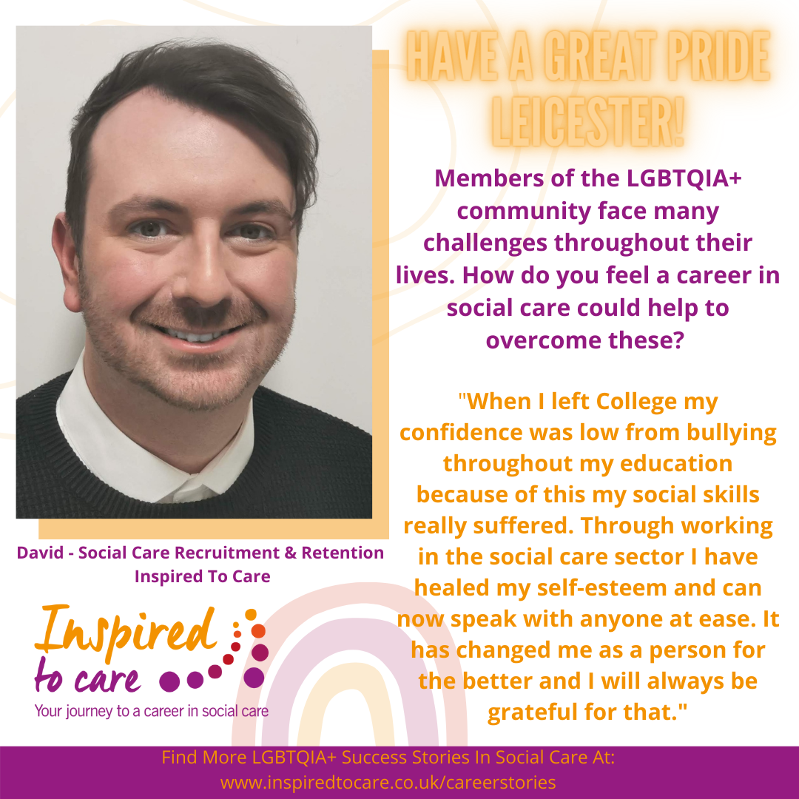
Support Local Events
Inspired To Care took part in celebrating this years Pride event in Leicester which was a fun way of showing how inclusive the Leicestershire County Council and social care are as an employer and sector. We asked our colleagues if they would like to be included and we had a lot of interest in taking part.

Slide 10
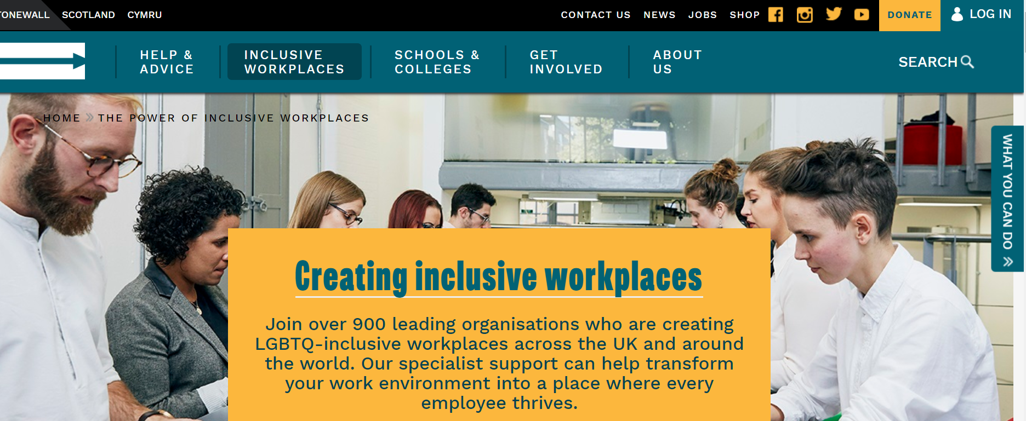
www.stonewall.org.uk

Slide 11
Follow our social media
Facebook: @InspiredtocareLeicestershire
Instagram: @inspired.to.care
LinkedIn: https://www.linkedin.com/company/inspired-to-care

