Slide 1
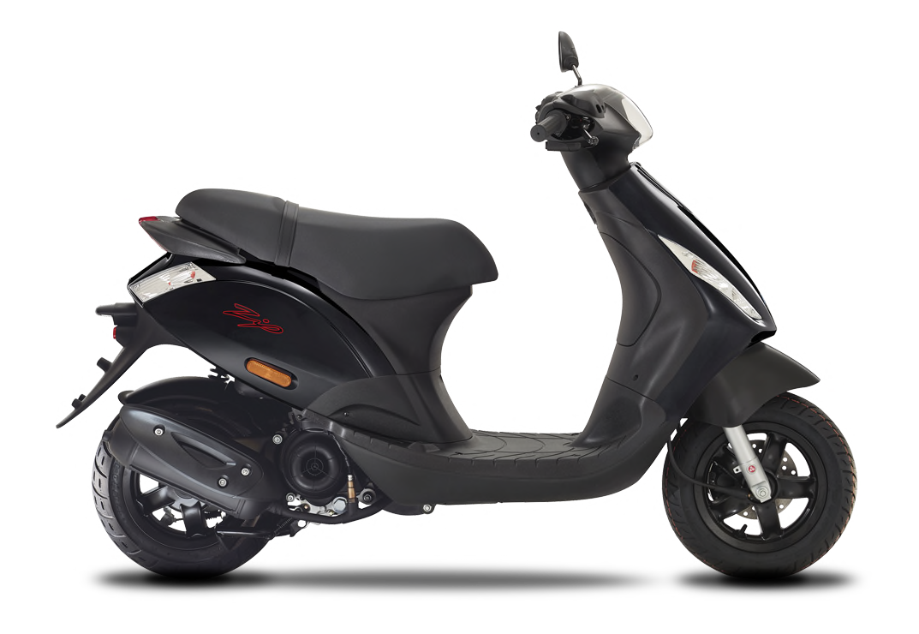
Welcome to
SILVERSTONE

Slide 2
introduction
Mark Smith-Young
Spyder Motorcycles & Wheels to Work Silverstone

Slide 3
WHAT IS WHEELS TO WORK?
Wheels to Work Silverstone provides scooter hire for those who are struggling with public transport and are either looking for work, currently employed, or in education and training.
We operate throughout nine counties: Northamptonshire, Buckinghamshire, Bedfordshire, Warwickshire, Oxfordshire, Leicestershire, Nottinghamshire, Berkshire & Shropshire.
Included within the rental fee is a tracked and insured scooter, a service plan, a lock, delivery (min. four-month hire), breakdown cover and independence!

Slide 4
INITIAL COSTS
There are some upfront costs associated with a successful Wheels to Work application.
Applicants who hold a valid provisional driving licence or a current CBT (Compulsory Basic Training) certificate will not be subject to these costs
A CBT is a day’s training undertaken to ensure a rider is safe to ride on the road; together with a provisional driving licence, the CBT is all someone needs to legally ride a scooter up to 125cc.
To hire a 50cc scooter the rider would need to be over 16 years of age, for a 125cc scooter the rider would need to be over 17.
Provisional Driving Licence | £34 online, £43 by post
CBT (Compulsory Basic Training) | From £150

Slide 5
THE APPLICATION PROCESS
Apply online
Provide proof of income, licence & CBT
Apply for a provisional driving licence if not held
Pass scooter Compulsory Basic Training (CBT) if not completed
Suitability call with one of the team
Send T&Cs
Pay initial deposit and first week of hire
Set up direct debit
Arrange scooter delivery date
Sign paperwork upon delivery

Slide 6
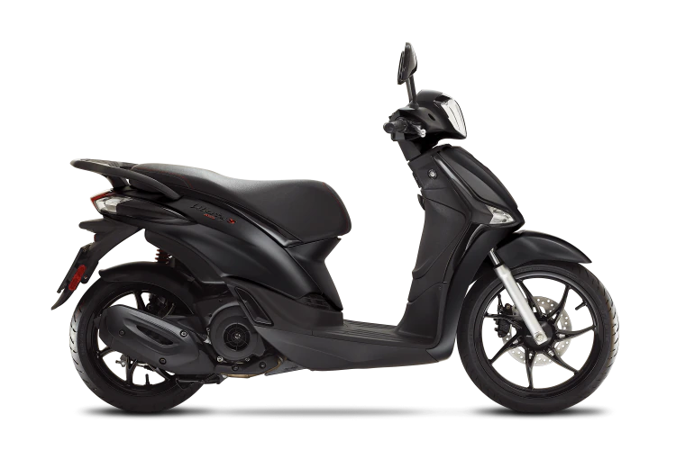
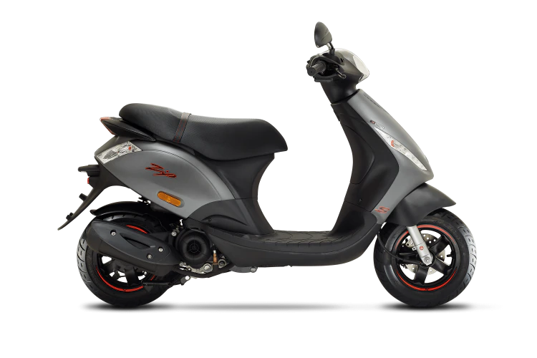
Scooters on the wheels to Work fleet
Piaggio – Zip 50
Piaggio – Liberty 125

Slide 7
SCOOTER cost
Hire Item | Hire Cost, Per Week
Piaggio Zip 50cc | From £51
Piaggio Liberty 125cc ABS | From £57
Insurance | Included in hire fee
Breakdown | Included in hire fee
Service Plan | Included in hire fee
Lock | Included in hire fee

Slide 8
Riding kit and clothing
Purchase Items | Cost
Helmet (legal requirement) | From £60
Armoured jacket (recommended) | From £65
Gloves (recommended) | From £25
Armoured trousers (recommended) | From £60
Water proof trousers (recommended) | From £15
Boots (recommended) | From £60

Slide 9
Benefits of scooter hire
Punctual, not reliant on public transport or lifts
A greener way to travel
Reduces road congestion
Lessen the space required for staff parking
Opens up recruitment to a younger, budget conscious workforce
Recruitment and retention incentive
Provides flexibility, freedom and connection with friends and family
Improves well-being
Scooter issues resolved within five working days

Slide 10
Working with the Care industry
The most cost-effective form of licensed, independent transport
More convenient transport option for international candidates
Insurance cover includes travelling from client to client
Reliable - all scooters are regularly serviced
Travel to clients more efficiently
Easy to parking
Top box can be fitted for more storage
Cost efficient for both carer and company

Slide 11
Testimonial
In what way has the scooter helped you get to work?
Having a scooter has helped me travel to work easier and cheaper than using public transport .
You’re a reliable company to rent from and always bring good scooters, keeping them in a high standard.
When a service is due you always swap the scooter to ensure I can continue my day as I need to.
How did you travel before you had the W2W scooter?
I used my own scooter, but it was continuously breaking down and causing me to be late or needing to be repaired. It was costing me more money than it does to rent regularly from you.
Carly - current customer and carer

Slide 12
OTHER INFORMATION
Funding can be sought through charities, local authorities, Jobcentre Plus and other organisations to assist with the CBT and/or rental payments either in part or full.
Potential to use Flexible Support Fund through JCP.
Rentals of over four months include delivery.
There is no maximum hire period.
A typical application can take between 2 to 7 working days.

Slide 13
CONTACT Wheels to Work
Wheels to Work Silverstone
Unit 18 Silverstone Park
Silverstone Circuit
NN12 8TL
www.wheelstowork.net
info@wheelstowork.net
01327 857213
Not-for-Profit, Private Limited Company by Guarantee, 12522995 Regulated by the FCA, FRN 926521

Slide 14
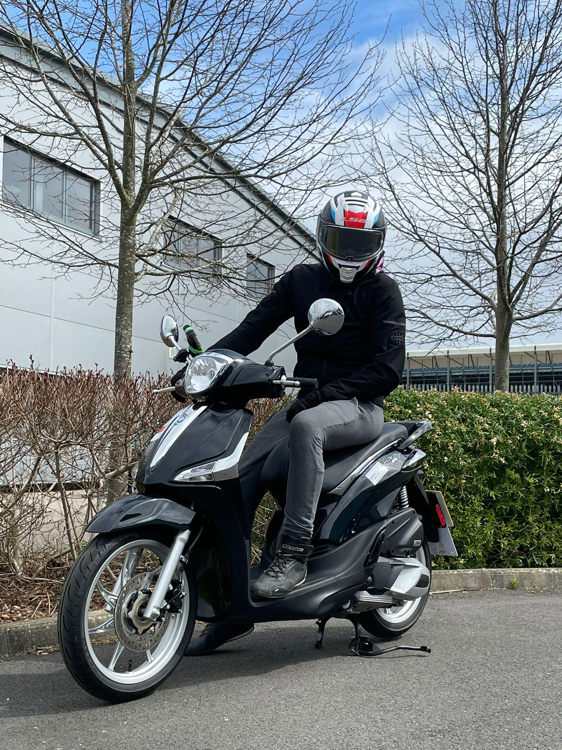
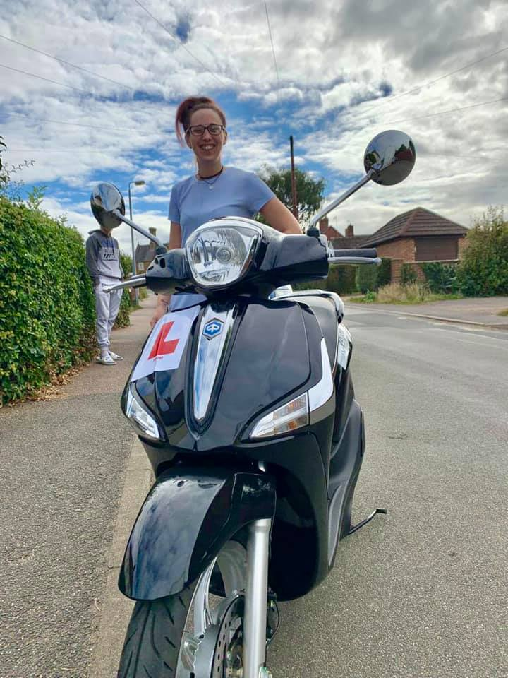
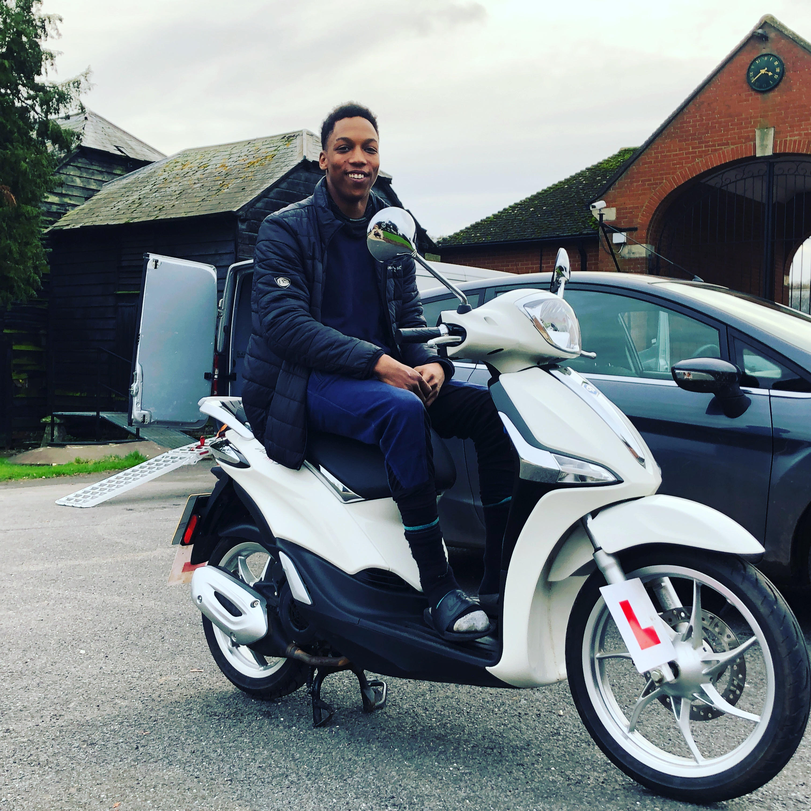
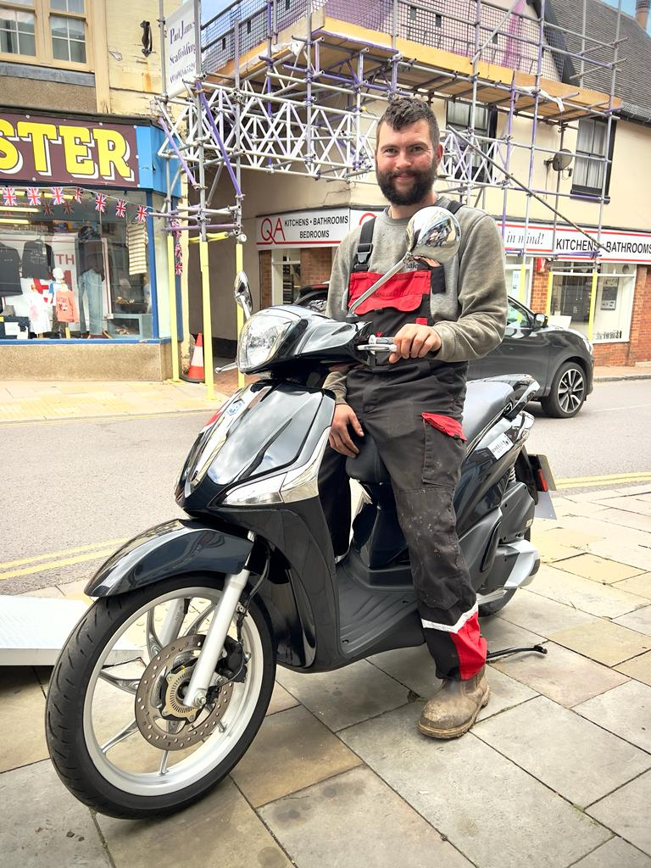
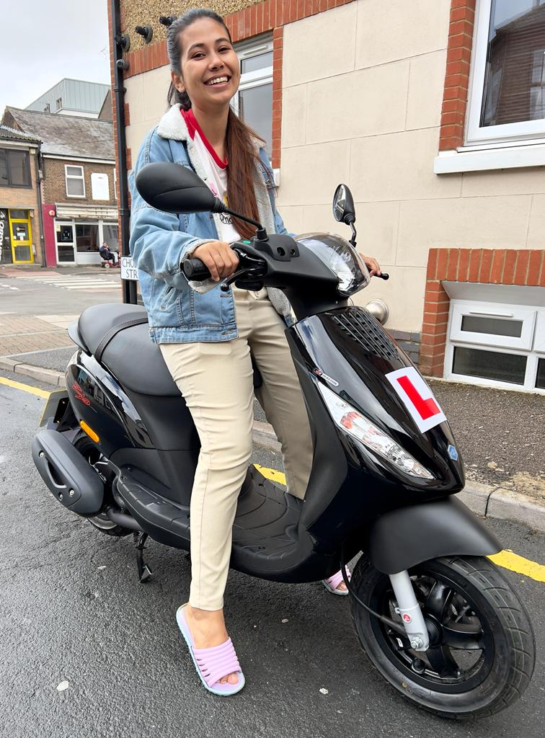
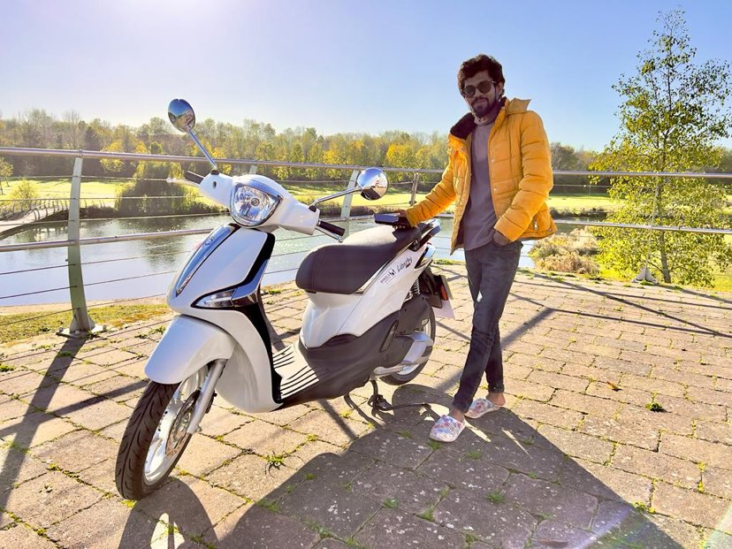
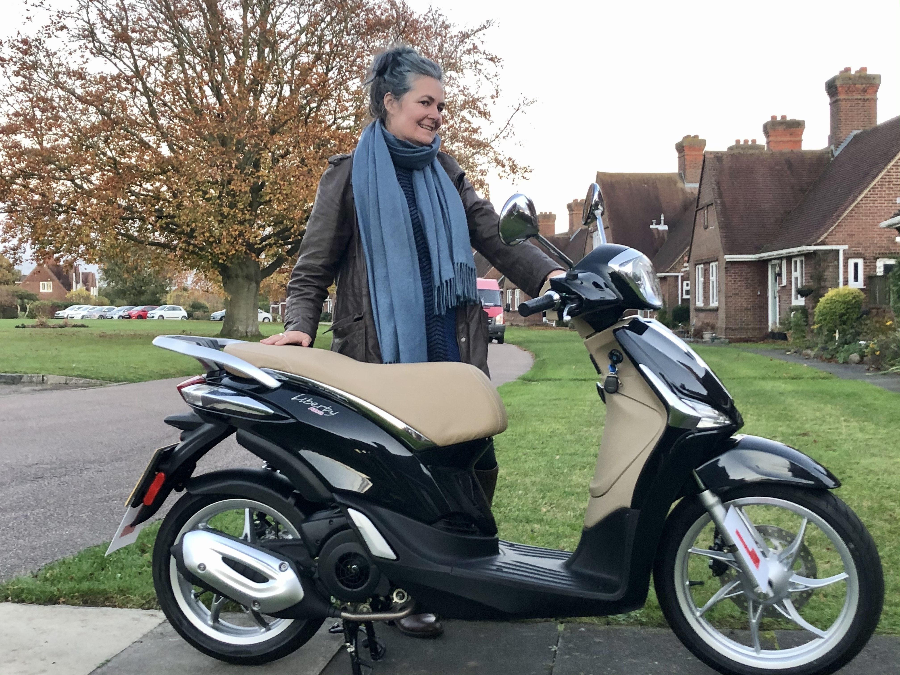
Wheels to work Silverstone

Slide 15
Any questions?

